Slide 1


Litty Tressa George
FICT

Slide 2
Introduction
Human brain has many incredible characteristics such as massive parallelism, distributed representation and computation, learning ability, generalization ability , adaptivity, which seems simple but is really complicated.
It has been always a dream for computer scientist to create a computer which could solve complex perceptual problems this fast.
ANN models was an effort to apply the same method as human brain uses to solve perceptual problems.
Three periods of development of ANN:
1940: Mcculloch and Pitts: Initial works( exact year 1943)
1960: Rosenblatt: perceptron convergence theorem (1958), Minsky and Papert: work showing the limitations of a simple perceptron
1980: Hopfield, Werbos and Rumelhart: Hopfield's energy approach/back-propagation learning algorithm

Slide 3
Biological Neuron
The basic computational unit of the brain is a neuron.
It is the structural and functional unit of human nervous system
An average human brain consists of approximately 10 billion neurons in the human nervous system. (Shepherd and Koch,1990)
Each of which is connected, on average, to several thousands of other neurons.
These connections are known as synapses, and the human brain contains about 60 trillion
such connections.
Each neuron contains a soma, which is the body of the neuron, an axon, and a number of dendrites.

Slide 4
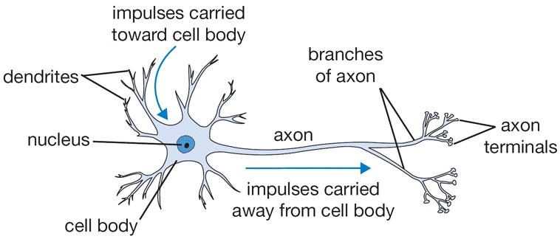
A Single Biological Neuron Structure

Slide 5
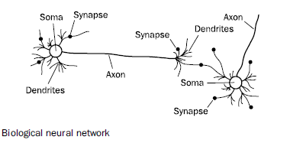
Biological Neural Network Structure

Slide 6
Bological Neuron Components
Three parts of a typical nerve cell : -
• DENDRITES: Accepts the inputs
• SOMA : Process the inputs
• AXON : Transmission of the processed inputs from the cell body .
Also there is a communication space between neurons called as SYNAPSES – It is the the electrochemical contact that exists between the neurons.
Each neuron receives input signals from its dendrites and produces output signals along its (single) axon.
The axon eventually branches out and connects via synapses to dendrites of other neurons.

Slide 7
Working Principle - BNN
The biological neuron receives input signals (electrical impulse) from other neurons along its dendrites,
The dendrites carry the input signals (electrical impulse)to the cell body where they all get processed.
An impulse, in the form of an electric signal, travels within the dendrites and through the cell body towards the pre-synaptic membrane of the synapse.
Upon arrival at the membrane, a neurotransmitter (chemical) is released in quantities proportional to the strength of the incoming signal.
The neurotransmitter present in the synapse, (strength of the synapse) and threshold of the next neuron, modifies the signal and this modified signal ( newly generated signal ) again passes through the next neuron in the network.
Note: The human brain far exceeds in terms of complexity any device created by man, or indeed, any naturally occurring object or structure in the universe, as far as we are aware today.

Slide 8
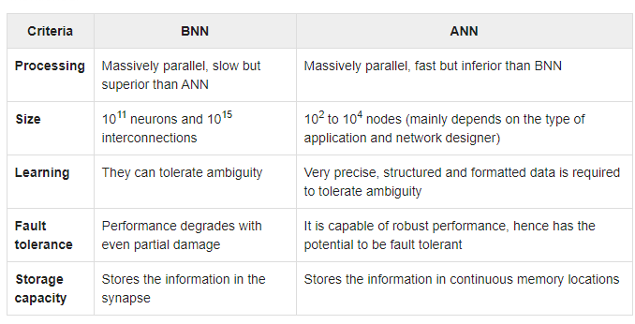
Comparison between ANN and BNN

Slide 9
Artificial Neurons
ANNs may be defined as structures comprised of densely inter-connected adaptive simple processing elements, (called artificial neurons or nodes) that are capable of performing massively parallel computations for data processing and knowledge representation (Hecht- Nielsen, 1990; Schalkoff, 1997).

Slide 10
Artificial Neurons
Artificial neural networks are modelled on the human brain and consist of a number of artificial neurons.
Neurons in artificial neural networks tend to have fewer connections than biological neurons, and neural networks are all (currently) significantly smaller in terms of number of neurons than the human brain.
The neurons that we examine in this chapter were invented by McCulloch and Pitts (1943) and so are often referred to as McCulloch and Pitts neurons.
Each neuron (or node) in a neural network receives a number of inputs.
A function called the activation function is applied to these input values, which results in the activation level of the neuron.
There are a number of possible functions that can be used in neurons.

Slide 11
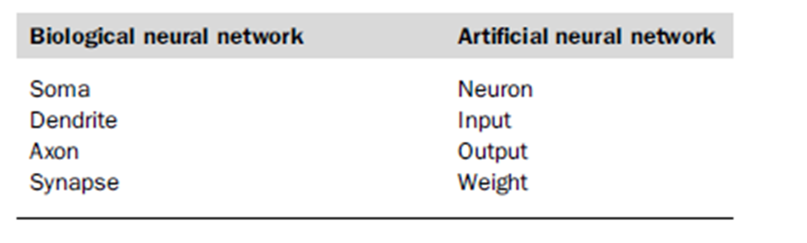
Analogy between biological and artificial neural networks

Slide 12
Activation function
The activation function maps the inputs into a corresponding output class.
The purpose of the activation function is to introduce non-linearity into the output of a neuron.
This is important because most real world data is non linear and we want neurons to learn these non linear representations.
Every activation function (or non-linearity) takes a single input and performs a certain fixed mathematical operation on it .
There are several activation functions you may encounter in practice:
Some of the most commonly used activation functions are illustrated in Fig.

Slide 13
Why do we need Activation Function ?
If an Activation function is not applied, then the output signal would simply be a simple linear function.
Now, a linear equation is easy to solve but they are limited in their complexity and have less power to learn complex functional mappings from data.
A Neural Network without activation function would simply be a Linear regression Model, which has limited power and does not performs good most of the times.
We want our Neural Network to not just learn and compute a linear function but something more complicated than that.
For eg; without activation function our Neural network would not be able to learn and model other complicated kinds of data such as images, videos , audio , speech etc.
That is why we use Artificial Neural network techniques such as Deep learning to make sense of something complicated ,high dimensional non-linear -big datasets, where the model has lots and lots of hidden layers in between and has a very complicated architecture which helps us to make sense and extract knowledge form such complicated big datasets.

Slide 14
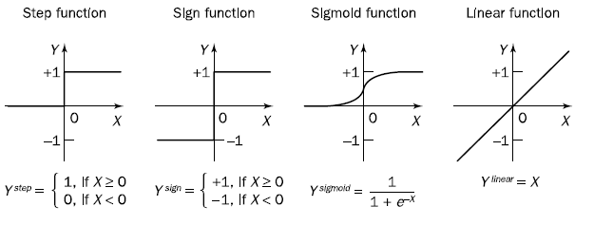
Activation functions of a neuron
In Figure, the x-axis of each graph represents the input value to the neuron, and the y-axis represents the output, or the activation level, of the neuron.

Slide 15
Step function
One of the most commonly used functions is the step function.
In using this function, the inputs to the neuron are summed (having each been multiplied by a weight), and this sum is compared with a threshold, t.
If the sum is greater than the threshold, then the neuron fires and has an activation level of +1.
Otherwise, it is inactive and has an activation level of zero. (In some networks, when the sum does not exceed the threshold, the activation level is considered to be 1 instead of 0).
The step and sign activation functions, also called hard limit functions, are often used in decision-making neurons for classification and pattern recognition tasks.

Slide 16
The sigmoid function transforms the input, which can have any value between plus and minus infinity (range of -∞ to + ∞ ) , into a reasonable value in the range between 0 and 1.
Neurons with this function are used in the back-propagation networks.
The linear activation function provides an output equal to the neuron weighted input.
Neurons with the linear function are often used for linear approximation

Slide 17
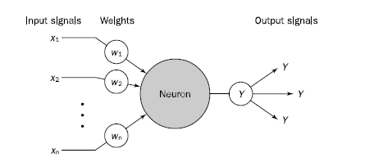
A Typical Neuron - as a simple computing element
The basic unit of computation in a neural network is the neuron, often called a node or unit. It receives input from some other nodes, or from an external source and computes an output. The output signal can be either a final solution to the problem or an input to other neurons. Each input has an associated weight (w), which is assigned on the basis of its relative importance to other inputs. A neural network ‘learns’ through repeated adjustments of these weights. Each neuron is an elementary information-processing unit.
The computation within neuron is split into two components.
First is a linear component, called the input function, that computes the weighted sum of the unit's input values.
Second is a nonlinear component called the activation function, g, that transforms the weighted sum into the final value that serves as the unit's activation value.
Fig: Diagram of a Neuron

Slide 18
Neural-Networks are considered Universal Function Approximators.
It means that they can compute and learn any function .
Almost any process we can think of can be represented as a functional computation in Neural Networks.
Hence it all comes down to this, we need to apply a Activation function f(x) so as to make the network more powerfull and add ability to it to learn something complex and complicated form data and represent non-linear complex arbitrary functional mappings between inputs and outputs.
Hence using a non linear Activation we are able to generate non-linear mappings from inputs to outputs

Slide 19
Working Principle of Artificial Neural Network
An ANN consists of a set of processor nodes or neurons that are connected together.
The connections between neurons have weights associated with them, and each neuron passes its output on to the inputs of the neurons to which it is connected.
This output depends on the application of the activation function to the inputs it receives.
In this way, an input signal to the network is processed by the entire network and an output (or multiple outputs) produced.
There is no central processing or control mechanism— the entire network is involved in every piece of computation that takes place.
When an input is given to a neural network, the output does not appear immediately because it takes some finite period of time for signals to pass from one neuron to another.

Slide 20
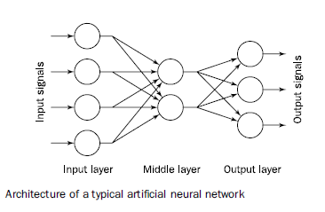

Slide 21

Typical Behaviour of a Neuron
Hence, the behaviour of the neuron can be expressed as follows:
X is the weighted sum of the n inputs to the neuron, x1 to , xn where each input, xn is multiplied by its corresponding weight wn.
For example, let us consider a simple neuron that has just two inputs. Each of these inputs has a weight associated with it, as follows:
w1 = 0.8
w2 = 0.4
The inputs to the neuron are x1 and x2:
x1 = 0.7
x2 = 0.9
So, the summed weight of these inputs is
(0.8 *0.7) + (0.4 *0.9) = 0.92
The activation level Y, is defined for this neuron as
Hence, if t is less than or equal to 0.92, then this neuron will fire with this particular set of inputs. Otherwise, it will have an activation level of zero.

Slide 22
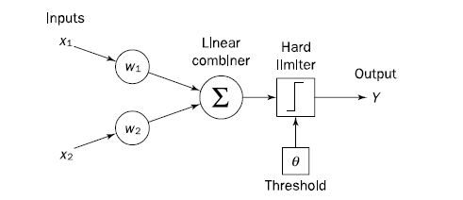
Can a single neuron learn a task?
In 1958, Frank Rosenblatt introduced a training algorithm that provided the first procedure for training a simple ANN: a perceptron (Rosenblatt, 1958).
The perceptron is the simplest form of a neural network.
It consists of a single neuron with adjustable synaptic weights and a hard limiter. A single-layer two-input perceptron is shown in Figure
Fig: Single-layer two-input perceptron

Slide 23
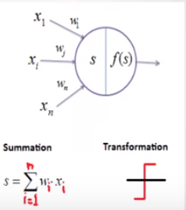
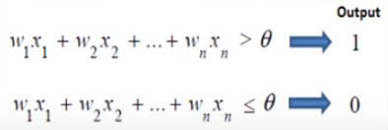
Perceptrons
The Perceptron models a neuron.
A neural network that has no hidden units is called a Perceptron
It receives ‘n’ inputs corresponding to the features of the data in the dataset.
A perceptron module consists of inputs, weights, summation processor and an activation function.
It sums those inputs (each weighted input), activates according to applied function and produces an output.
It is used to classify linearly separable classes.
Often used for binary classification.

Slide 24
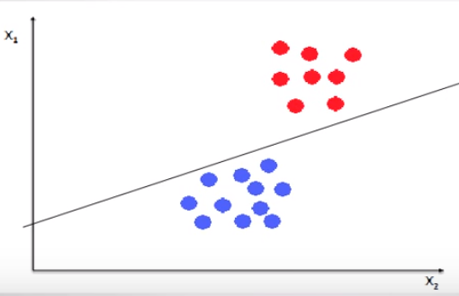
Perceptrons

Slide 25
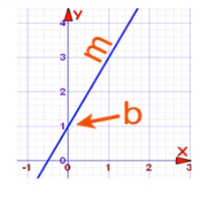
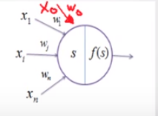
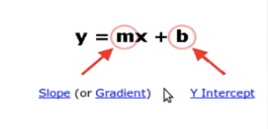
Perceptrons
Bias
Perceptron has another input known as bias.
It is a normal practice of treating bias as just another input.
The bias allows as to shift the transfer function curve horizontally along the input axis, while leaving the curvature unaltered.

Slide 26
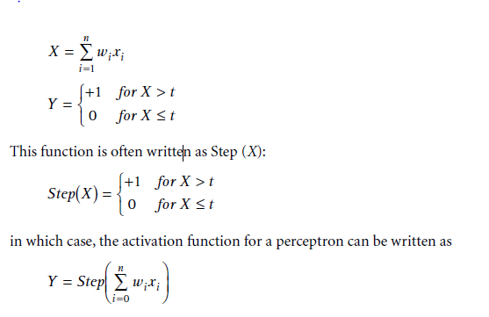
Perceptrons
The perceptron, which was first proposed by Rosenblatt (1958), is a simple neuron that is used to classify its inputs into one of two categories.
The perceptron can have any number of inputs, which are sometimes arranged into a grid.
This grid can be used to represent an image, or a field of vision, and so perceptrons can be used to carry out simple image classification or recognition tasks.
A perceptron uses a step function that returns +1 if the weighted sum of the inputs, X, is greater than a threshold, t, and 0 if X is less than or equal to t

Slide 27
A single perceptron can be used to learn a classification task, where it receives an input and classifies it into one of two categories: 1 or 0.
We can consider these to represent true and false, in which case the perceptron can learn to represent a Boolean operator, such as AND or OR
The learning process or training a perceptron is as follows:
First, random weights are assigned to the inputs.
Typically, these weights will be chosen between -0.5 and +0.5.
Next, an item of training data is presented to the perceptron, and its output classification observed.
If the output is incorrect, the weights are adjusted to try to more closely classify this input.
In other words, if the perceptron incorrectly classifies a positive piece of training data as negative, then the weights need to be modified to increase the output for that set of inputs.

Slide 28
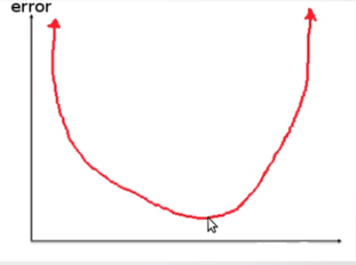
Error
e is defined as 0 if the output is correct, and otherwise it is positive if the output is too low and negative if the output is too high.
If the error, e(p), is positive, we need to increase perceptron output Y(p), but if it is negative, we need to decrease Y(p).

Slide 29

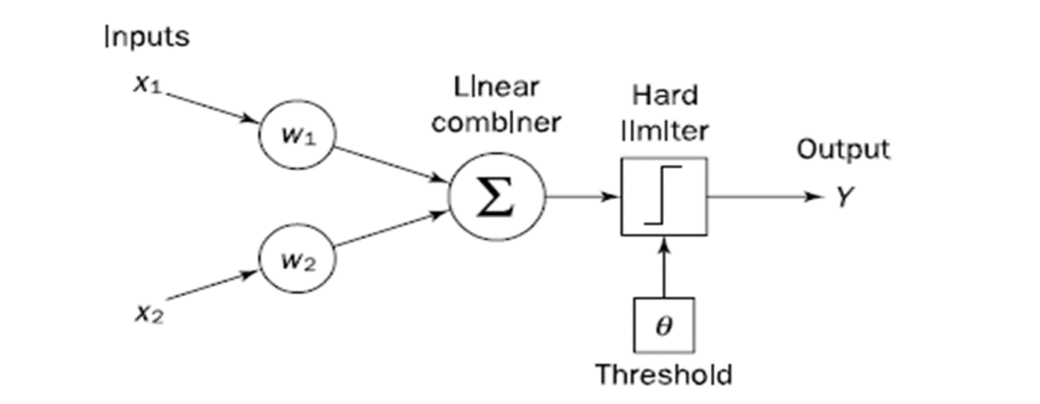
The model consists of a linear combiner followed by a hard limiter.
The weighted sum of the inputs is applied to the hard limiter, which produces an output equal to +1 if its input is positive and -1 if it is negative.
The aim of the perceptron is to classify inputs, or in other words externally applied stimuli x1; x2; . . . ; xn, into one of two classes, say A1 and A2.
Thus, in the case of an elementary perceptron, the n-dimensional space is divided by a hyperplane into two decision regions.
The hyperplane is defined by the linearly separable function

Slide 30

Perceptron Training Process
where e is the error that was produced ie error rate (expected output – actual output) , and a is the learning rate, where 0 < a < 1;
e is defined as 0 if the output is correct, and otherwise it is positive if the output is too low and negative if the output is too high.
If the error, e(p), is positive, we need to increase perceptron output Y(p), but if it is negative, we need to decrease Y(p).
This rule is known as the perceptron training rule.
The process starts again, until all the weights are correct and all errors are zero.
Each iteration of this process is known as an epoch.

Slide 31
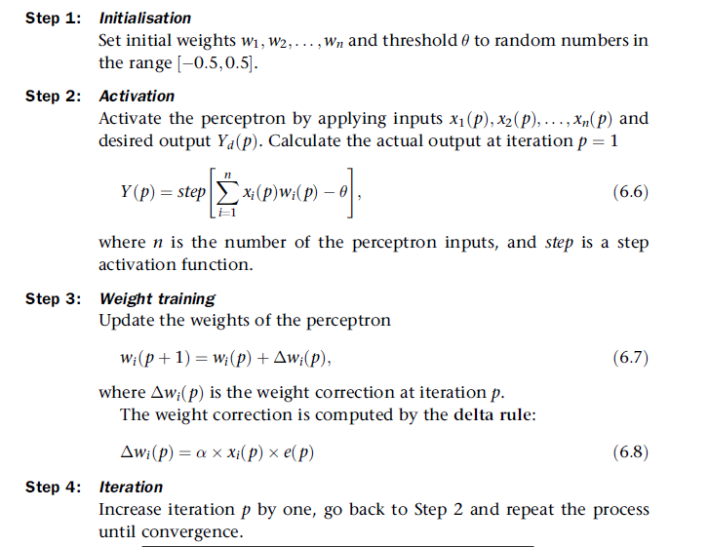
Perceptron Training Algorithm

Slide 32
Perceptron Training - Example
Consider a simple example: we will see how a perceptron can learn to represent the logical-OR function for two inputs.
We will use a threshold of zero (t = 0) and a learning rate of 0.2.
First, the weight associated with each of the two inputs is initialized to a random value between 1 and +1:
w1 = 0.2
w2 = 0.4
Now, the first epoch is run through. The training data will consist of the four combinations of 1’s and 0’s possible with two inputs.

Slide 33
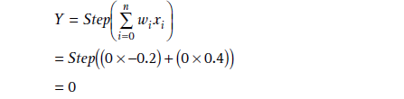
Epoch 1
Hence, our first piece of training data is
x1 = 0
x2 = 0
and our expected output is x1 ∨ x2 = 0.
We apply our formula for Y:
Hence, the output Y is as expected, and the error, e, is therefore 0. So the weights do not change.

Slide 34
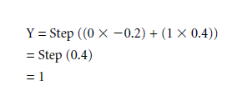
Now, for x1 = 0 and x2 = 1
Again, this is correct, and so the weights do not need to change.:

Slide 35



For x1 = 1 and x2 = 0:
This is incorrect because 1 ∨ 0 = 1, so we should expect Y to be 1 for this set of inputs. Hence, the weights are adjusted.
We will use the perceptron training rule to assign new values to the weights:
Our learning rate is 0.2, and in this case, the e is 1, so we will assign the following
value to w1:

Slide 36

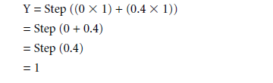
We now use the same formula to assign a new value to w2:
Because w2 did not contribute to this error, it is not adjusted.
The final piece of training data is now used (x1 = 1 and x2= 1):
This is correct, and so the weights are not adjusted.
This is the end of the first epoch, and at this point the method runs again and continues to repeat until all four pieces of training data are classified correctly.

Slide 37
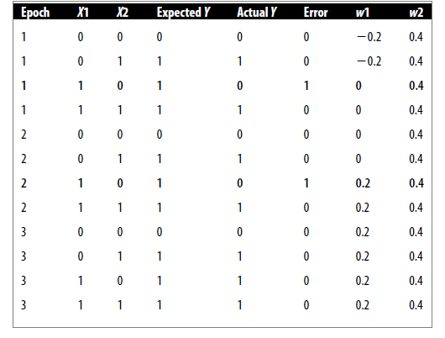
A sample run showing how the weights change for a simple perceptron
when it learns to represent the logical OR function

Slide 38
The table showed the complete sequence—it takes just three epochs for the perceptron to correctly learn to classify input values.
Lines in which an error was made are highlighted.
After just three epochs, the perceptron learns to correctly model the logical- OR function.
In the same way, a perceptron can be trained to model other logical functions such as AND, but there are some functions that cannot be modelled using a perceptron, such as exclusive OR.
This is because perceptron's can only learn to model functions that are linearly separable.
A linearly separable function is one that can be drawn in a two-dimensional graph, and a single straight line can be drawn between the values so that inputs classified into one classification are on one side of the line, and inputs classified into the other are on the other side of the line.

Slide 39
Limitations of Single-Layer Perceptron
Well, there are two major problems:
Single-Layer Perceptron's cannot classify non-linearly separable data points.
Complex problems, that involve a lot of parameters cannot be solved by Single-Layer Perceptron's.

Slide 40
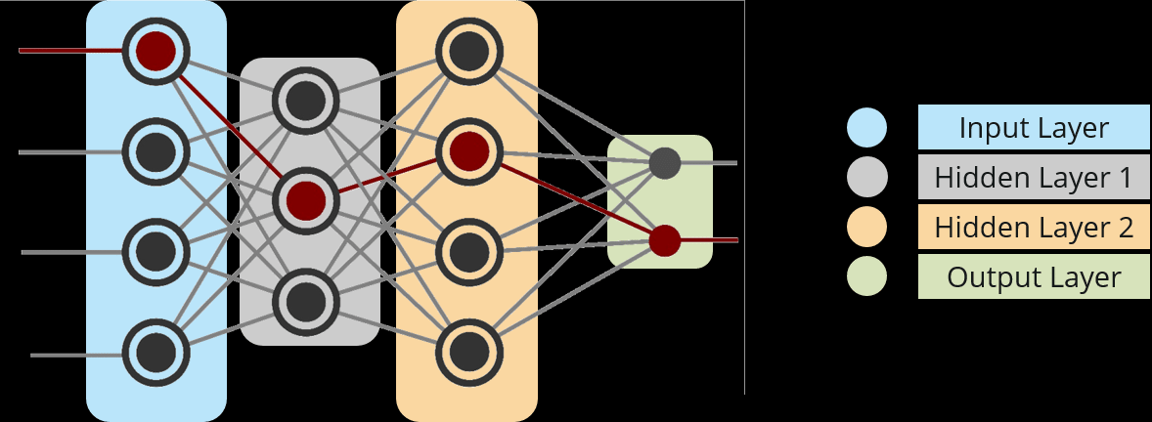
Multi Layer Neural Network
A typical architecture for a multilayer neural network is shown in Figure .
The network shown is a feed-forward network, consisting of three layers.
A fully connected multi-layer neural network is called a Multilayer Perceptron (MLP).
A simple three-layer feedforward neural network

Slide 41
Multi Layer Neural Network
Input Nodes – The Input nodes provide information from the outside world to the network and are together referred to as the “Input Layer”. No serious processing is performed in any of the Input nodes – they just pass on the information to the hidden nodes.
Hidden Nodes – The Hidden nodes have no direct connection with the outside world (hence the name “hidden”). They perform computations and transfer information from the input nodes to the output nodes. A collection of hidden nodes forms a “Hidden Layer”. While a network will only have a single input layer and a single output layer, it can have zero or multiple Hidden Layers, ideally most practical applications uses three, because each additional layer increases the computational burden exponentially. (experimental n/w may have five or even six). A hidden layer ‘hides’ its desired output. In other words, the desired output of the hidden layer is determined by the layer itself. A Multi-Layer Perceptron has one or more hidden layers.
Output Nodes – The Output nodes are collectively referred to as the “Output Layer” and are responsible for computations and transferring information from the network to the outside world.

Slide 42
A multilayer neural network can represent a very broad set of nonlinear functions which perceptron's couldn’t.
This structure is called multilayer because it has a layer of processing units (i.e., the hidden units) in addition to the output units.
The connections never skip a layer.
Typically, the layers are fully connected, meaning that all units at one layer are connected with all units at the next layer.
So, this means that all input units are connected to all the units in the layer of hidden units, and all the units in the hidden layer are connected to all the output units.
The network is called feed-forward because data are fed in forward direction from the input nodes through to the output nodes.
A typical neural network consists of an input layer, one or more hidden layers, and an output layer, and each layer may have any no : of neurons in between 10 and 1000

Slide 43
Backpropagation
Multilayer neural networks learn in much the same way as single perceptron's.
The main difference is that in a multilayer network, each neuron has weights associated with its inputs, and so there are a far greater number of weights to be adjusted when an error is made with a piece of training data.
How to assign credit to the various weights ?
More than a hundred different learning algorithms are available, but the most popular method is back-propagation.
This method was first proposed in 1969 (Bryson and Ho, 1969), but was ignored because of its demanding computations.
Only in the mid-1980s was the back-propagation learning algorithm rediscovered.

Slide 44
Backpropagation
Back-propagation is the essence of neural net training. It is the practice of fine-tuning the weights of a neural net based on the error rate (i.e. loss) obtained in the previous epoch (i.e. iteration). Proper tuning of the weights ensures lower error rates, making the model reliable by increasing its generalization.

Slide 45
How Backpropagation Algorithm Works
In a back-propagation neural network, the learning algorithm has two phases.
First, a training input pattern is presented to the network input layer.
The network then propagates the input pattern from layer to layer until the output
pattern is generated by the output layer.
If this generated pattern is different from the desired output, an error is calculated and then propagated backwards through the network from the output layer to the input layer.
The weights are modified as the error is propagated.
As with any other neural network, a back-propagation one is determined by the connections between neurons (the network’s architecture), the activation function used by the neurons, and the learning algorithm (or the learning law) that specifies the procedure for adjusting weights.
Typically, a back-propagation network is a multilayer network that has three or four layers.
The layers are fully connected, that is, every neuron in each layer is connected to every other neuron in the adjacent forward layer.

Slide 46
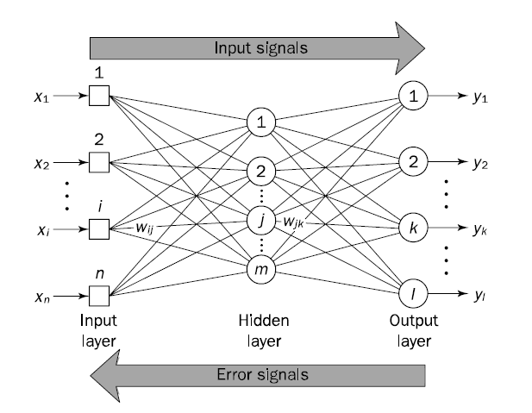
How Backpropagation Works

Slide 47
Why We Need Backpropagation?
Most prominent advantages of Backpropagation are:
It has no parameters to tune apart from the inputs and weights.
It is a flexible method as it does not require prior knowledge about the network
It is a standard method that generally works well
It does not need any special mention of the features of the function to be learned.

Slide 48
Most prominent disadvantages of Backpropagation are:
The actual performance of backpropagation on a specific problem is dependent on the input data.
Backpropagation can be quite sensitive to noisy data

Slide 49

Rather than using the simple Step function that single perceptron's use, multilayer backpropagation networks usually use the sigmoid function,
The sigmoid function is defined as follows:
Note: sigmoid function cannot actually reach 0 or 1, it is usual to accept a value such as 0.9 as representing 1 and 0.1 as representing 0.

Slide 50
Tasks for you !!.
Derive Back Propagation Algorithm Pseudocode.
Reference Text : Artificial Intelligence - A Guide to Intelligent Systems , Michael Negnevitsky chapter 6,, Page 179.
2. State the Methodologies for Improving the Performance of Backpropagation
Reference Text : Artificial Intelligence Illuminated , chapter 11 , Page 305

Slide 51
Learning, in artificial neural network, is the method of modifying the weights of connections between the neurons of a specified network.
Learning in ANN can be classified into three categories namely:
Supervised Learning,
Unsupervised Learning,
Reinforcement Learning.

Slide 52
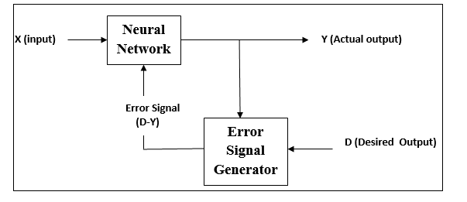
Supervised Learning
As the name suggests, this type of learning is done under the supervision of a supervisor.
This learning process is dependent.
During the training of ANN under supervised learning, the input vector is presented to the network, which will give an output vector. This output vector is compared with the desired output vector. An error signal is generated, if there is a difference between the actual output and the desired output vector. On the basis of this error signal, the weights are adjusted until the actual output is matched with the desired output.

Slide 53
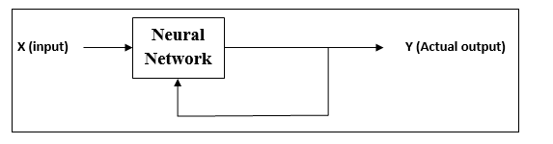
Unsupervised Learning
As the name suggests, this type of learning is done without the supervision .
This learning process is independent.
During the training of ANN under unsupervised learning, the input vectors of similar type are combined to form clusters. When a new input pattern is applied, then the neural network gives an output response indicating the class to which the input pattern belongs.
There is no feedback from the environment as to what should be the desired output and if it is correct or incorrect. Hence, in this type of learning, the network itself must discover the patterns and features from the input data, and the relation for the input data over the output.

Slide 54
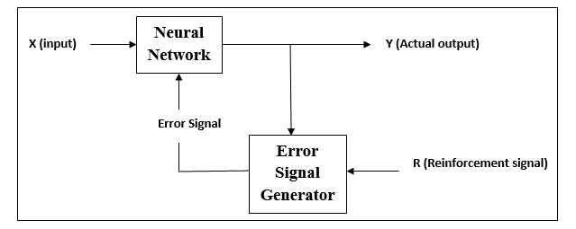
Reinforcement Learning
As the name suggests, this type of learning is used to reinforce or strengthen the network over some critic information. This learning process is similar to supervised learning, however we might have very less information.
During the training of network under reinforcement learning, the network receives some feedback from the environment. This makes it somewhat similar to supervised learning. However, the feedback obtained here is evaluative not instructive, which means there is no supervisor as in supervised learning. After receiving the feedback, the network performs adjustments of the weights to get better critic information in future.

